Slide 1

Fire and Smoke Detection
ITA0515 - COMPUTER VISION
GUIDED BY:
Dr .Carmel Mary Belinda M J
SIMATS ENGINEERING
PRESENTED BY:
A.Shiva Shankar Reddy (192425174)
K.Mounith (192425090)

Slide 2


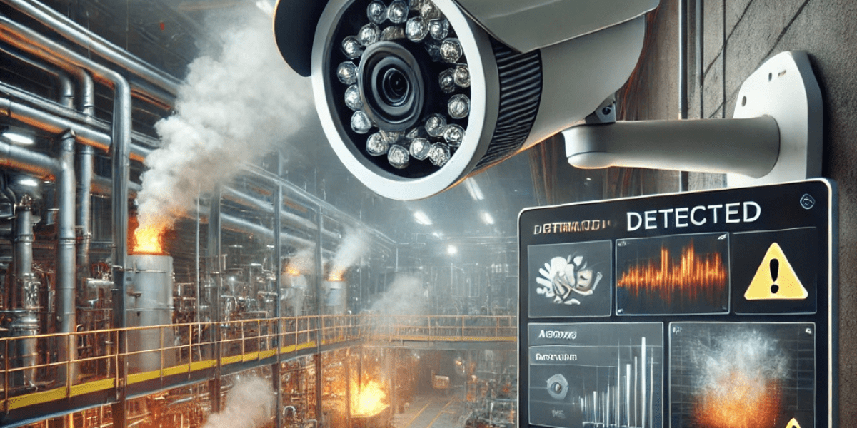
Introduction
Fire accidents can cause loss of life and property.
Early detection of fire and smoke helps prevent major damage.
This project uses image processing to identify fire and smoke from images or videos.
The system enhances the image, detects fire, and generates an alarm.
It can be used in homes, industries, offices, and public places for safety.

Slide 3

Abstract
Fire accidents cause serious loss of life and property.
Early detection is important for safety and damage prevention.
Traditional systems may not detect every situation quickly.
This project uses Computer Vision to detect fire and smoke from images and videos.
The system provides fast and automated detection.
It generates an early warning when fire or smoke is detected.
It can be used in homes, industries, offices, warehouses, and public places.
The main aim is to improve safety and reduce fire-related damage.

Slide 4
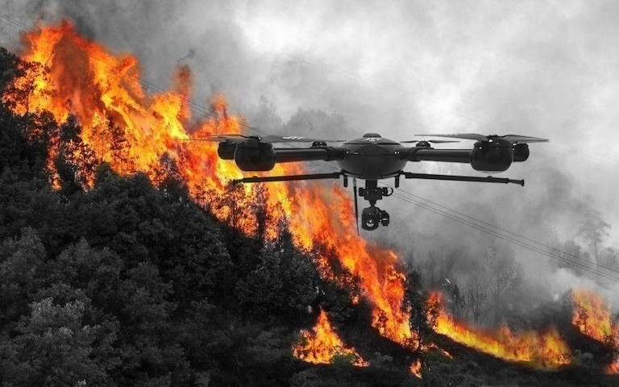
Objective
Detect fire and smoke at an early stage.
Improve image quality for better detection.
Identify fire accurately using image processing techniques.
Generate an alarm immediately after fire detection.
Reduce damage by providing quick alerts.
Increase safety in homes and industries.

Slide 5
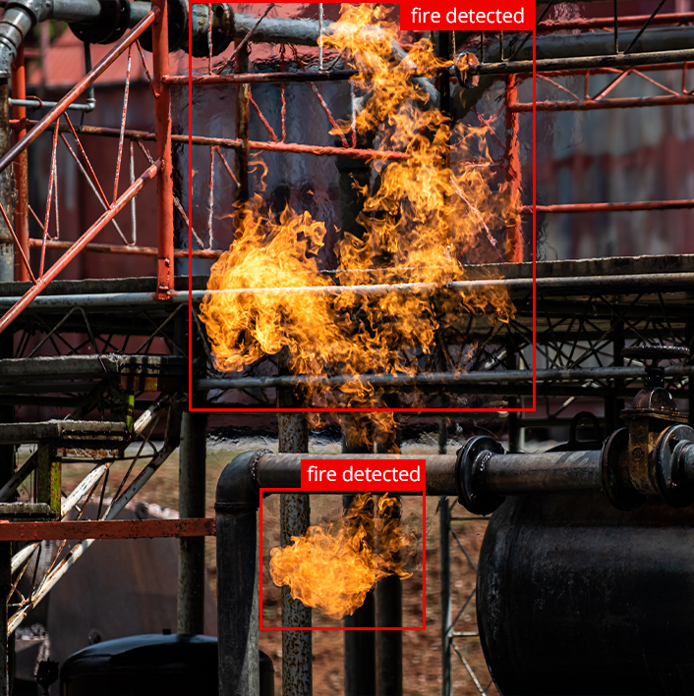
Problem Statement
Manual monitoring cannot detect fire all the time.
Traditional smoke sensors may not detect fire quickly in large areas.
Poor image quality can reduce detection accuracy.
Delay in fire detection may cause severe damage.
A smart system is needed to automatically detect fire and generate instant alerts.

Slide 6
Year | Author(s) | Paper Title | Journal Name | Methodology | Advantages | Disadvantages
2024 | Diego Gragnaniello et al. | Fire and Smoke Detection from Videos: A Literature Review Under a Novel Taxonomy | Fire Research and Management Exchange System | Reviewed deep learning and computer vision techniques for video-based fire detection. | Covers many datasets and methods; useful for understanding current approaches. | Review paper only; does not propose a new detection model.
2025 | Ammar Amjad et al. | Dynamic Fire and Smoke Detection Module with Enhanced Feature Integration and Attention Mechanisms | Pattern Analysis and Applications | Attention mechanism with deep learning for fire and smoke detection. | High detection accuracy and better feature extraction. | Requires a large labeled dataset and higher computational cost.
2026 | Umesh Kumar Lilhore | Real time fire and smoke detection using vision transformers and spatiotemporal learning | Scientific Reports | Vision Transformer combined with spatiotemporal learning for analyzing fire and smoke in images and video. | Uses both spatial and temporal information; suitable for video-based monitoring. | More computationally intensive than lightweight CNN or YOLO models.

Slide 7
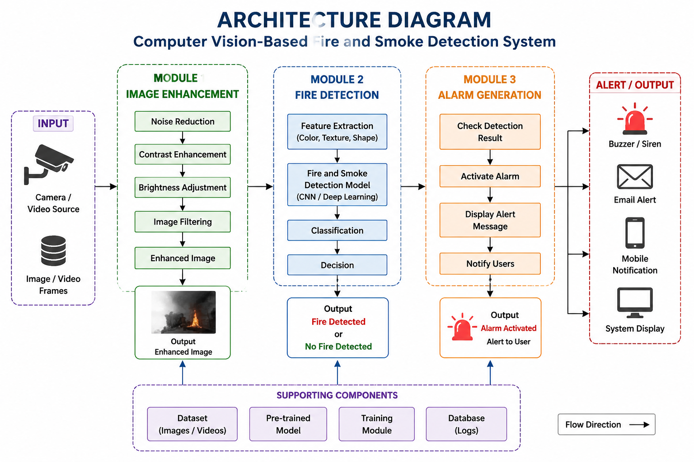

Slide 8
Module 1: Image Enhancement
Description:
Capture the input image or video from a camera.
Improve image quality by removing noise.
Adjust brightness and contrast.
Enhance the image for better fire detection.
Output;
Enhanced and clear image ready for processing.

Slide 9
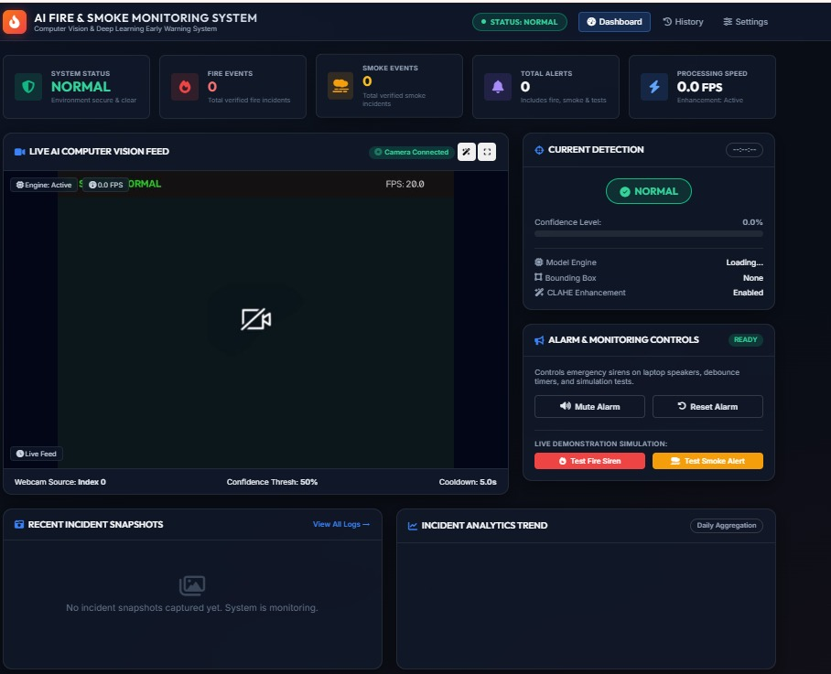
Module 1 OUTPUT

Slide 10
Module 2: Fire Detection
Description
Analyze the enhanced image.
Detect the presence of fire and smoke using computer vision.
Identify fire based on color, shape, and motion features.
Display the detection result.
Output
Fire Detected or No Fire Detected.

Slide 11
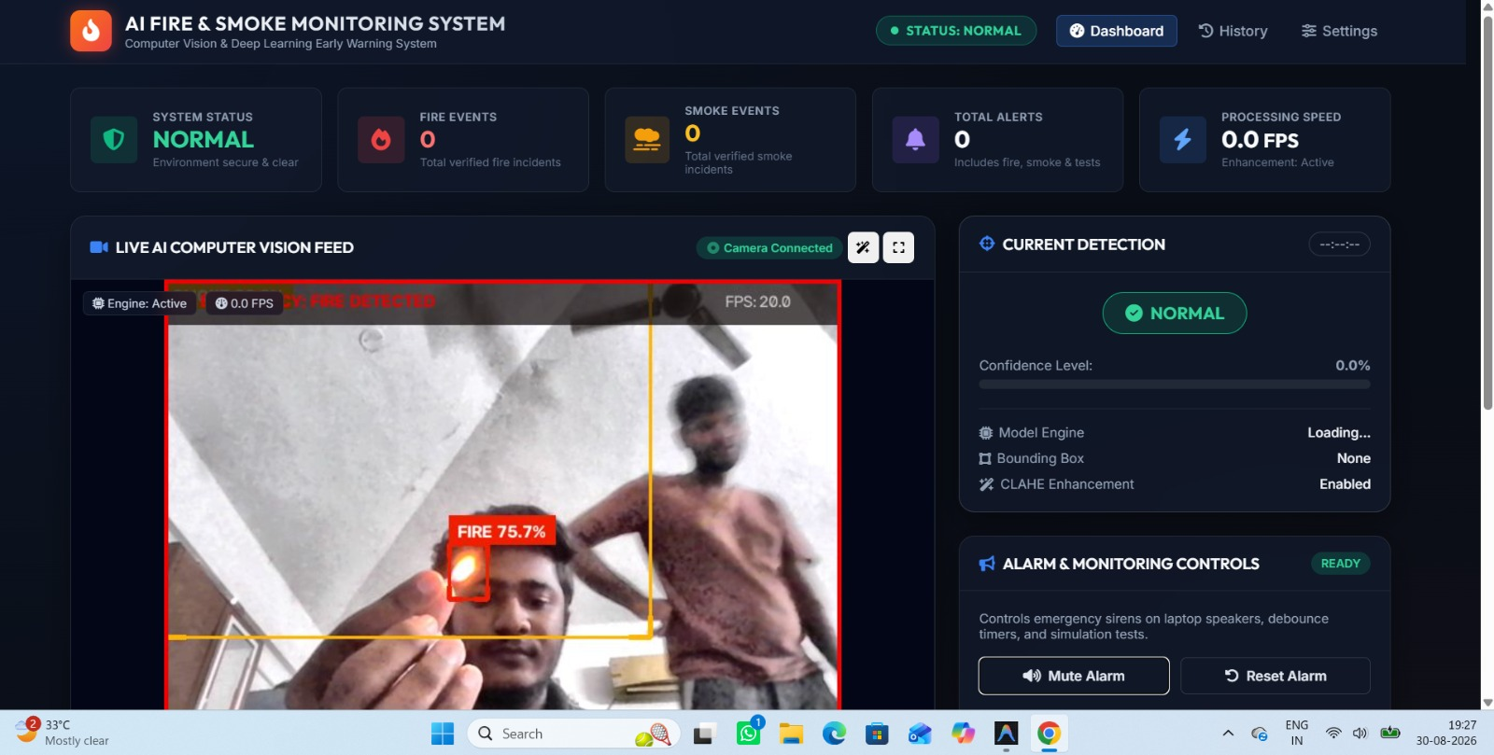
Module 2: OUTPUT

Slide 12
Module 3: Alarm Generation
Description
Check the fire detection result.
Generate an alarm if fire or smoke is detected.
Display a warning message.
Alert users for immediate action.
Output
Alarm activated with a warning notification.

Slide 13
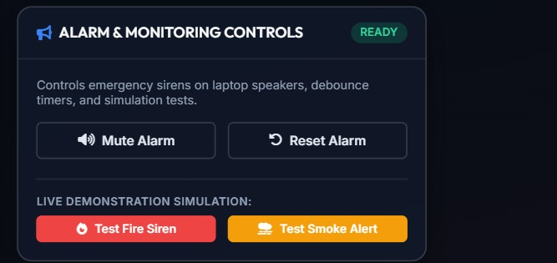
Module 3:OUTPUT

Slide 14

IMPLEMENTATION

Slide 15
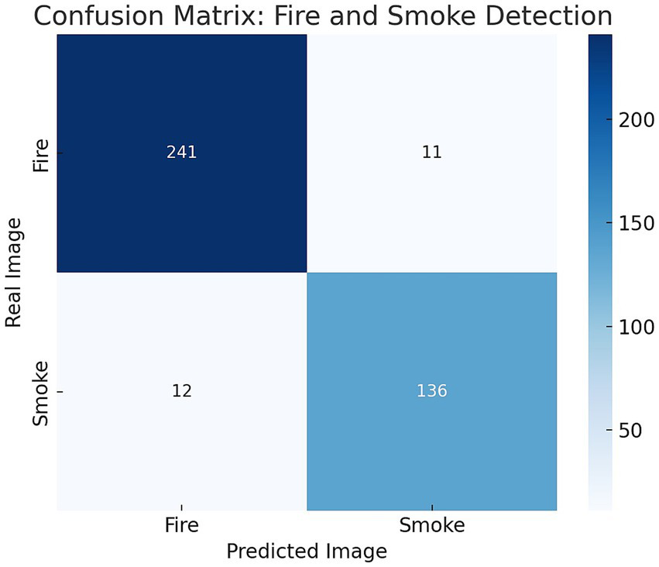
Results and Discussions
High Detection Accuracy: The system effectively detects fire and smoke from images and video frames.
Real-Time Performance: Computer vision models provide fast detection and support real-time monitoring.
Early Warning: The system can generate alerts quickly, helping reduce possible loss of life and property.
Improved Safety: The proposed approach can be useful in homes, industries, offices, warehouses, and public places.

Slide 16
Conclusion
The Fire and Smoke Detection Using Computer Vision system provides an effective solution for detecting fire and smoke.
Computer Vision and AI enable fast and automated detection from images and videos.
The system helps provide early warnings, improving safety and reducing potential damage.
It can be applied in homes, industries, offices, warehouses, forests, and public places.

Slide 17
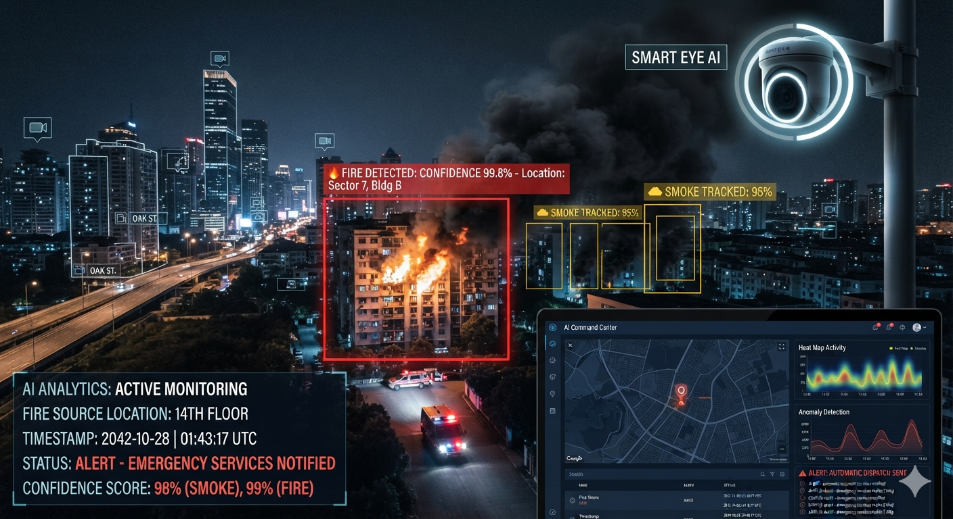
Future Scope
Real-Time CCTV Monitoring: Detect fire and smoke continuously from live camera feeds.
Mobile Notifications: Send instant alerts to users through a mobile application.
IoT Integration: Connect the system with sensors and IoT devices for better monitoring.
Cloud Integration: Store detection results and images securely in the cloud.
Improved AI Models: Use advanced deep learning models to improve detection accuracy.
Multiple Camera Support: Monitor multiple locations simultaneously from a single dashboard.

Slide 18

References
Amjad, A., Huroon, A. M., Chang, H.-T., & Tai, L.-C. (2025). Dynamic Fire and Smoke Detection Module with Enhanced Feature Integration and Attention Mechanisms. Pattern Analysis and Applications, 28(2), Article 81. https://doi.org/10.1007/s10044-025-01461-6.
Abozeid, A., & Alanazi, R. (2026). An Intelligent Approach for Early Smoke/Fire Detection Using Vision Sensors in Smart Cities. Scientific Reports, 16, Article 11387.
Lilhore, U. K., et al. (2026). Real Time Fire and Smoke Detection Using Vision Transformers and Spatiotemporal Learning. Scientific Reports, 16, Article 8928.
Wang, C. (2025). Wildfire Smoke Detection System: Model Architecture, Training Mechanism, and Dataset. International Journal of Intelligent Systems.

Slide 19


